Slide 1
Landscape Unit Objectives in the M-KMA
Prepared for: M-KMA Board
February 2020

Slide 2
Background
The local strategic plan for forest and range use is landscape unit objectives(LUO)
Fox and OBO landscape units (Mackenzie Forest District) have LUO
Forest Industry in the Northeast focusing their activities outside of the M-KMA (i.e. not pursuing grandfathered blocks)
Increasing pressure to look at developing LUO

Slide 3
Drivers
Timber Supply
Fires and Beetle (external)
TSR -pressure to move north and west
Concern from First Nations about Cumulative Effects on FSJ TSA Core Area
MK-MA Legislation- reflect the uniqueness of the area
Maintain wilderness characteristics, wildlife and it’s habitat
Opportunities to work jointly with First Nations
FSJ LRMP Amendment

Slide 4
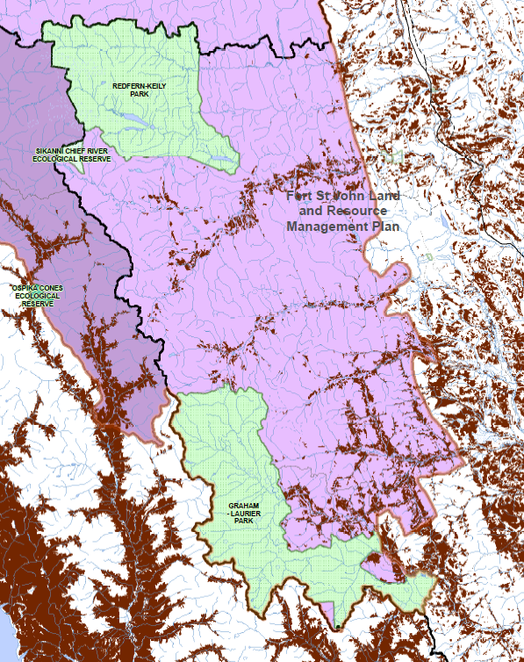

Slide 5
Objectives for creating LUO
Meet the legislated management intent of the M-KMA
Recognize the unique wilderness characteristics, wildlife and its habitat
Provide certainty for the Forest Industry
Notes:
The management intent for the Muskwa-Kechika Management Area is to ensure wilderness characteristics, wildlife and its habitat are maintained over time while allowing resource development and use, including recreation, hunting, timber harvesting, mineral exploration and mining, oil and gas exploration and development.

Slide 6
Legislative Role of Board
Providing advice to the Province on corporate priorities for local strategic planning
Support initiation of local strategic plans
Ensure adequate public consultation in prep and approval of plans

Slide 7
LUO Process Considerations
FSJ LRMP Amendment
Forum for setting land use objectives
Parallel legal objectives
Mechanisms for First Nations’ collaboration and public consultation
Data generation
M-KMA Unique
Process
Defining how to maintain wilderness quality through resource management direction
Scale

Slide 8
LUO Considerations - Linkages
Regional Strategic Environmental Assessment Project and the cumulative effects framework
Existing Local Strategic Plans
Park Management Planning

Slide 9
Other Considerations
United Nations Declaration on the Rights of Indigenous Peoples (UNDRIP)
First Nations Areas of Interest
Forestry legislative amendments
Caribou
Climate Change
Access Management
Existing Tenures

Slide 10
Next Steps
Map process
Scope M-KAB Interests
What has been done to date (e.g. defining wilderness quality)?
What is the M-KAB’s interests around the scope of LUOs?
E.g. Fox and Obo LUOs
Range of value components
Temporal and spatial scale
Other considerations (e.g. climate change)
What do you need from the Province for this?

Slide 11
Thank-You
Questions/Discussion?

