Slide 1
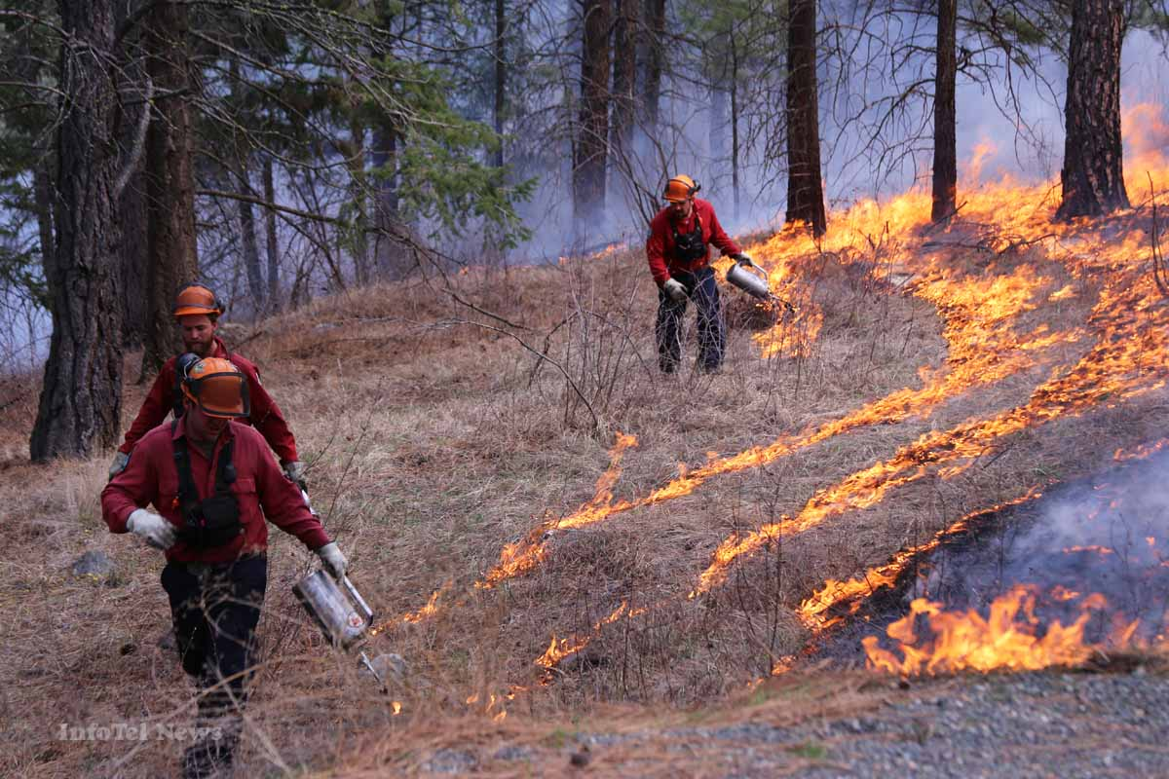

Peace-Liard Prescribed Fire Strategy Development
Muskwa Kechika Board Presentation
June 2018

Slide 2
Project Background
Prescribed fire has been implemented by government since the mid-1970s
Recent prescribed fires occurred within the Muskwa-Kechika primarily for Stone’s sheep, mountain goat, and elk
Few prescribed fires were ignited outside of the Muskwa-Kechika due to private land and critical infrastructure
New program intends to implement prescribed fire across the Northeast Region

Slide 3
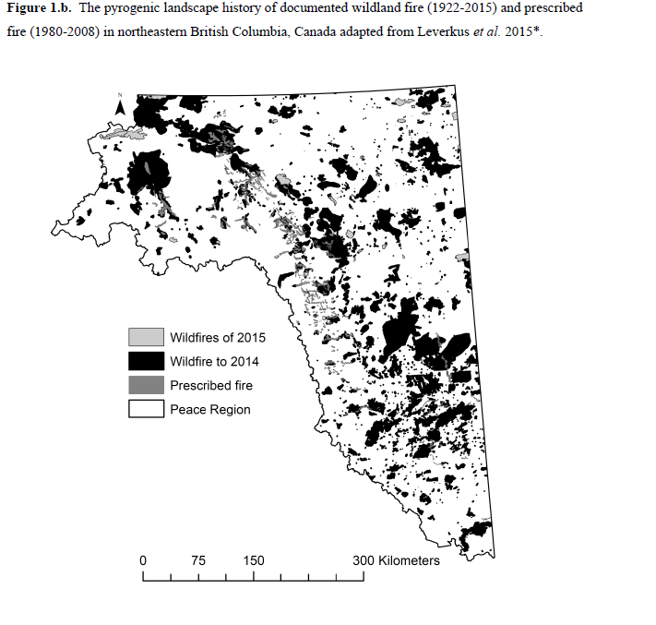
Leverkus 2015 (Conserving biodiversity PhD thesis) and Leverkus et al. 2016 JEM

Slide 4
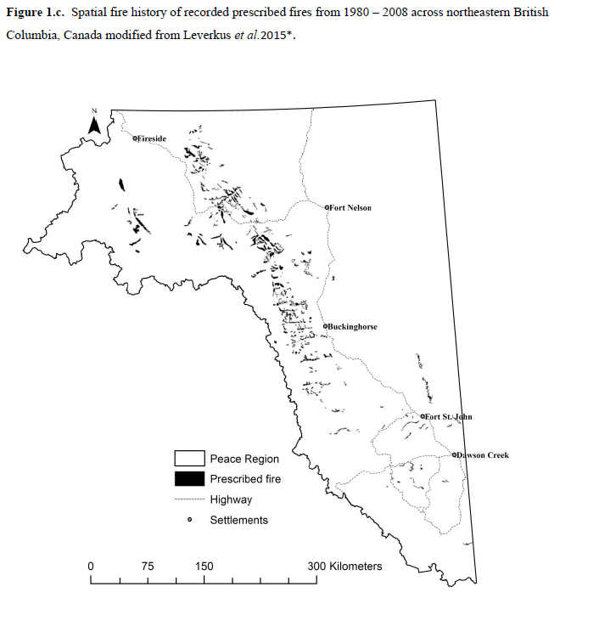
Leverkus 2015 (Conserving biodiversity PhD thesis) and Leverkus et al. 2016 JEM

Slide 5
Shift of Paradigm
Past burn plans have been segregated, with each agency taking care of their own needs through fire with no integration and with little engagement from stakeholders and First Nations
Our goal is to create a unified prescribed fire plan that is developed with stakeholders and First Nations and incorporates the needs and objectives of all other government agencies

Slide 6
Co-operation and Partnership
Community Meetings – to discuss experience with fire, address questions and concerns with prescribed fire and identify key values
Mapping Workshops – blank maps of the communities and the Northeast are provided, participants are asked to draw polygons, FLNRO staff ask questions and record the data in a corresponding spreadsheet
Continual and Open Communication – constant communication, sharing products with communities that developed them

Slide 7
Prescribed Fire Values
Prescribed fire can support the following values:
  Fuel load management
  Remove logging debris
  Silviculture preparation
  Reduce vegetation competition
  Wildlife habitat (e.g. moose)
  Control disease
  Cultural values
  Improve forage
  Improve access
  Support fire-dependent species
  Species at Risk
  Nutrient cycling
  Aesthetics

Slide 8
What will be shared?
The information is going into a decision making document. FLNR will have access to all the info you provide.
A public document will be created. Information will be protected with:
Buffers
Removal of Identifiers
Removal of specifics ie: simple Burn/ No Burn label

Slide 9
Streamline Plan and Process
Have plan and priorities set out allowing government agencies and 3rd parties to access and apply to burn
Create one application process for any type of prescribed fire in the Northeast
Create process of streamlined review and consultation

Slide 10
Links and Dependencies
PLMMP
Cumulative Effects Framework
RSEA
SEAR, Caribou
Forest Carbon Initiative
Range Use Plans
Community Fire Prevention Plans
Park Use Plans
G2G agreements

Slide 11
Critical Success Factors
Commitment and participation from team members
Support from Management and Executive
Management of expectations for additional information requirements through communication
First Nation and Stakeholder engagement around planning considerations
Integrated and coordinated First Nations Consultation
Liability

Slide 12
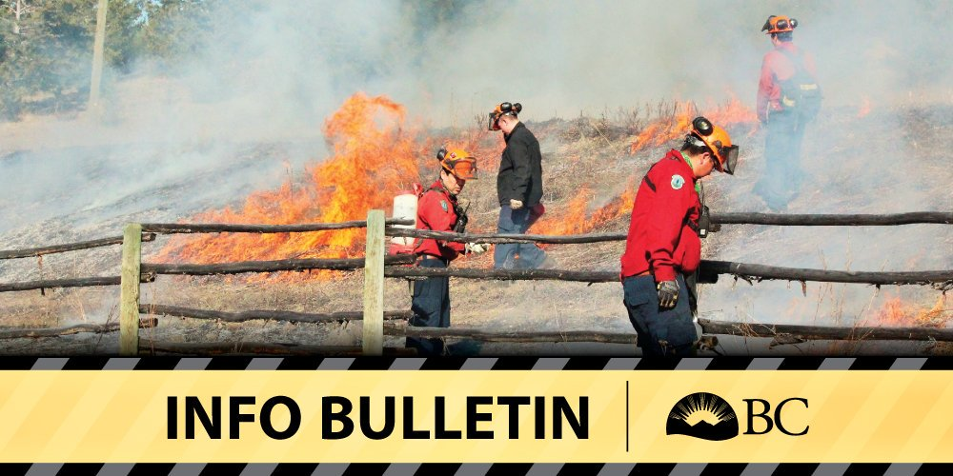
Progress to Date
Completed a literature review
Prepared the Stable Planning Document
Decision Point Tool
First Nations and Stakeholder Engagement (on going)

Slide 13
What’s to Come
First Nations and Stakeholder Engagement (continuation)
Update land-base restrictions with FN and Stakeholder interests
Identify priority areas for prescribed fire
Develop prescribed fire application (draft stage) and review process (early stages)
Formal consultation for planning document
Develop integrated monitoring protocol

Slide 14
Disclaimer
This is a new plan and process, and we hope very much that everyone will join into our collaborative effort, working together to share resources.
There is still the option for prescribed fire to happen outside of this plan; the proponent will have to follow the old approval processes, hold all of the liability, and burn themselves

Slide 15
Application ID: Reviewer:
Criteria for Consideration | Weak (1 point) | Moderate (2 points) | Strong (3 points) | Excellent (4 points) | Score
VALUES
Reduce fuel loads
Remove logging debris
Silviculture preparation
Reduce vegetation competition
Enhance wildlife habitat
Cultural value
Control insects/disease
Improve forage for herbivory
Aesthetic enhancement
Improve access
Support fire-dependent species
Nutrient cycling
Species/Ecosystems at risk
DOCUMENTATION
Burn Plan complete?
Other documents (required Impact Assessment Documents, engagement with First Nations, engagement with tenure-holders, evidence of other engagement (or describe the lack of need)?
Shapefiles submitted (.kmz or .kml files)?
Community Knowledge form (spreadsheet)?
Documentation of certifications, experience, training, insurance?
EVIDENCE FOR SUCCESSFUL IMPLEMENTATION AND COMPLETION OF THE PROJECT
Training
Experience
Additional funding
Equipment
Partnerships
Budget
OVERALL SCORE
% SCORE (DIVIDE OVERALL SCORE BY 96 THEN MULTIPLY BY 100)

Slide 16
